Slide 1
脑静脉窦血栓之诊断概要
福建医科大学附属第一医院影像科
郑 贤 应

Slide 2
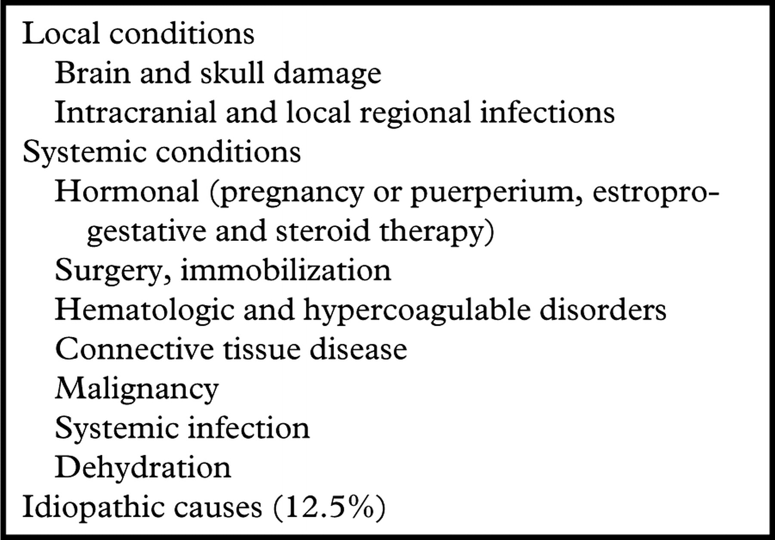
Causes of and Predisposing Factors for Cerebral Venous Thrombosis

Slide 3
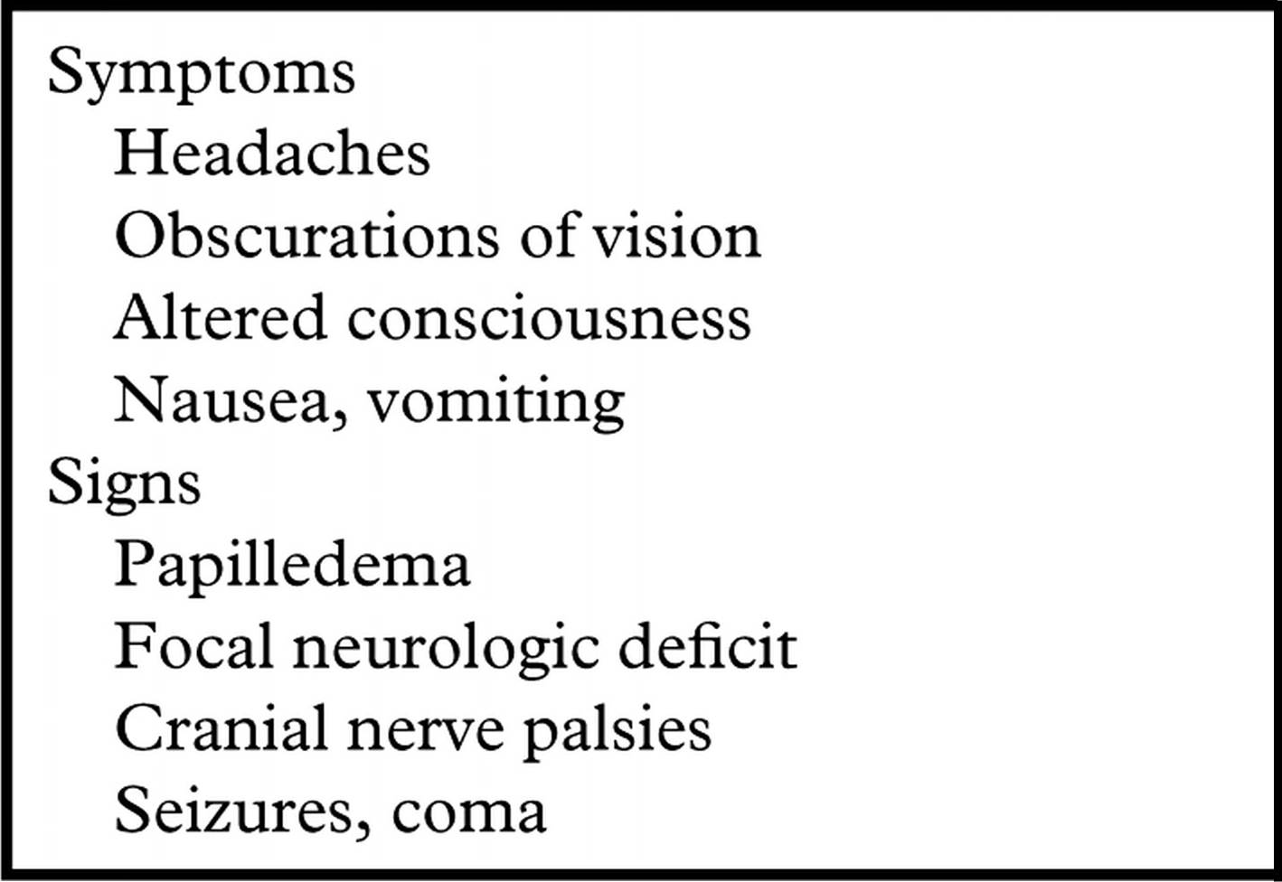
Clinical Features of Cerebral Venous Thrombosis

Slide 5
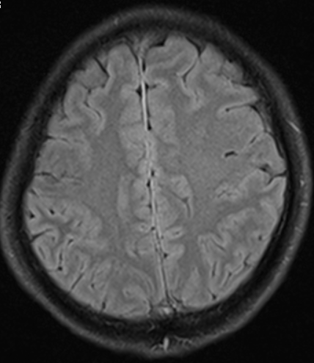

Slide 6
Acute stage (0–5 days)
In the acute stage of thrombus formation, the signal is predominantly isointense on T1WI and hypointense on T2WI because of deoxyhemoglobin in red blood cells trapped in the thrombus

Slide 7
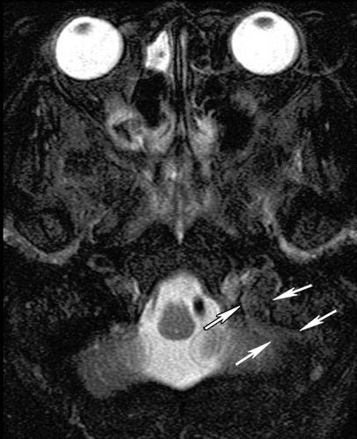
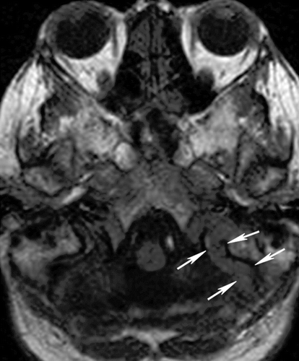
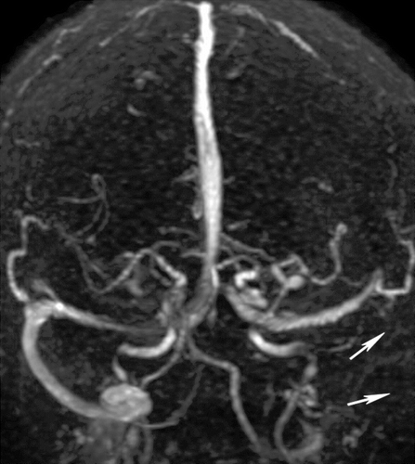

Slide 8
Subacute stage (6–15 days)
In the subacute stage of thrombus development， the signal is predominantly hyperintense on both T1WI and T2WI because of methemoglobin in the thrombus

Slide 9
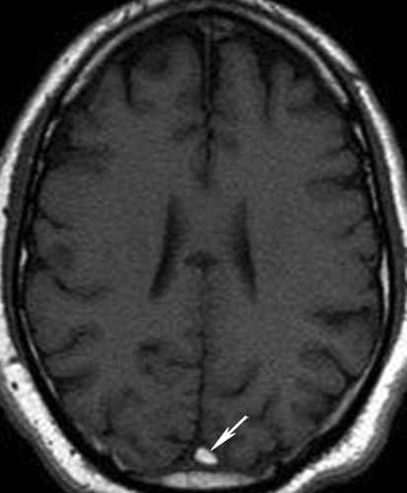
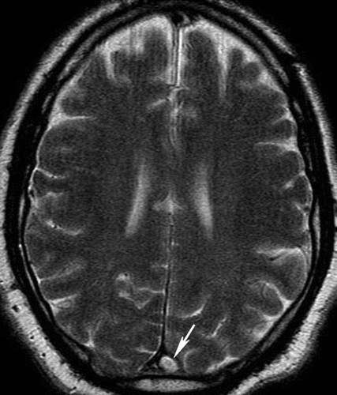
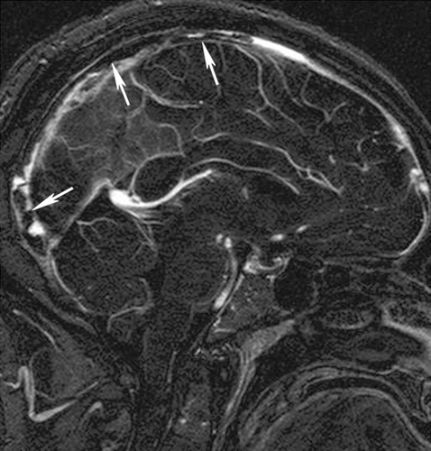

Slide 10
Chronic stage (>15-day-old)
the signal in a chronic thrombus is typically isointense or hyperintense on T2WI and isointense on T1WI
Sinus enhancement is presumably secondary to an organized thrombus with intrinsic vascularization as well as to slow flow in dural and intrathrombus collateral channels

Slide 11
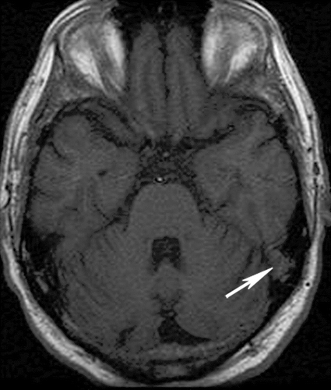
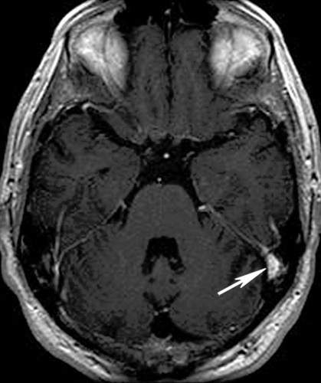

Slide 12
主要CT征象

Slide 13
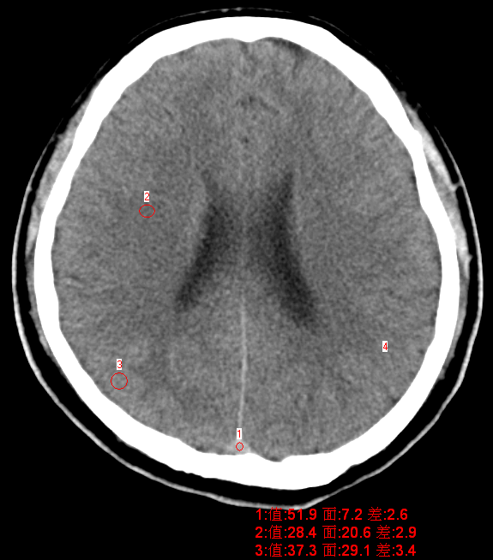
正常静脉窦CT值
？

Slide 14
正常颅脑组织CT值
脑灰质CT值34-39Hu
脑白质CT值26-29Hu
静脉窦CT值40-60Hu

Slide 15
直接征像
？

Slide 16
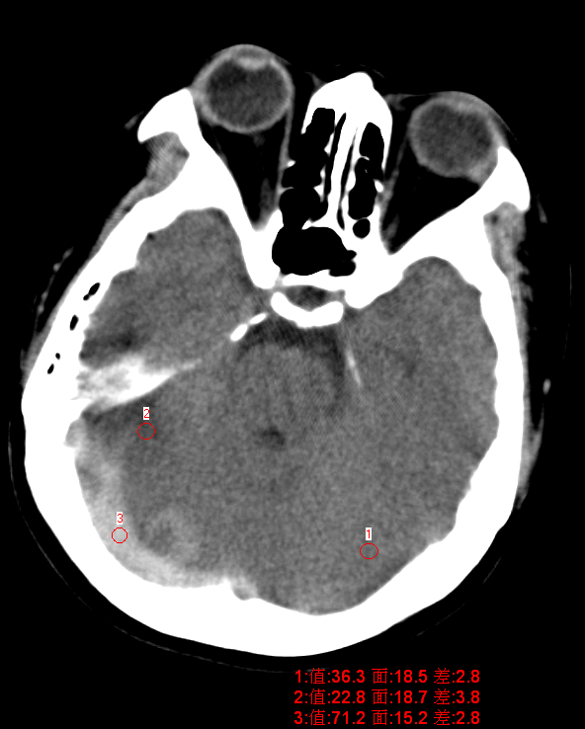
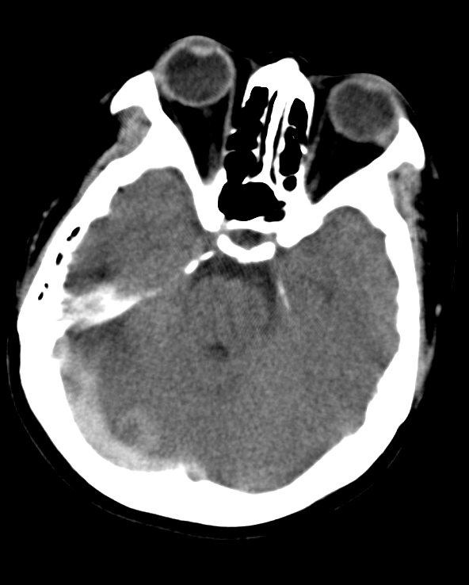
束带征（索条征）

Slide 17
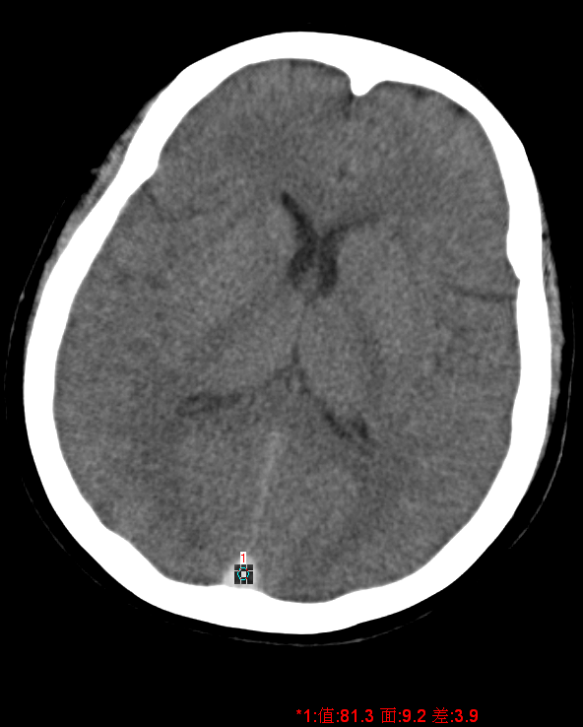
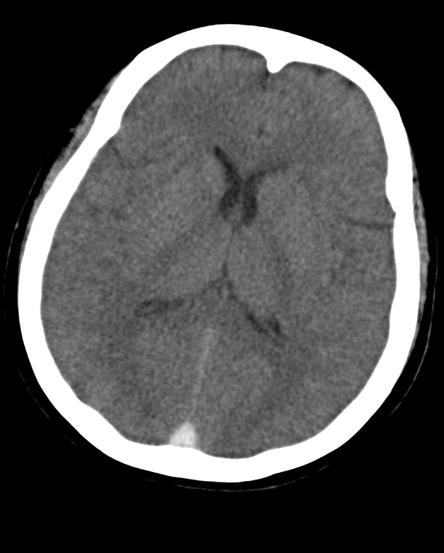
高密度三角征

Slide 18
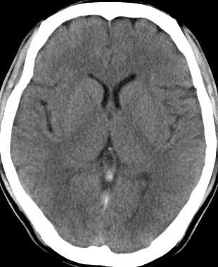
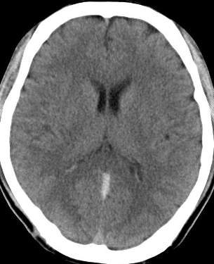
直窦及大脑大静脉血栓

Slide 19
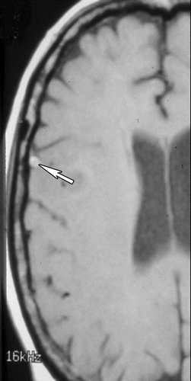
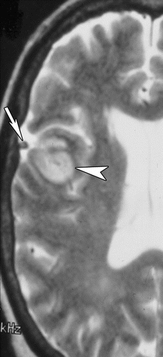

Slide 20
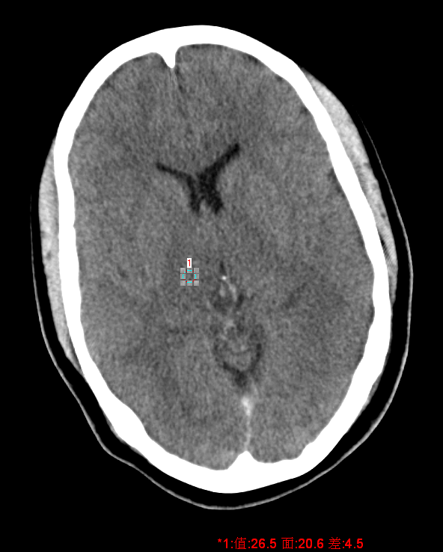
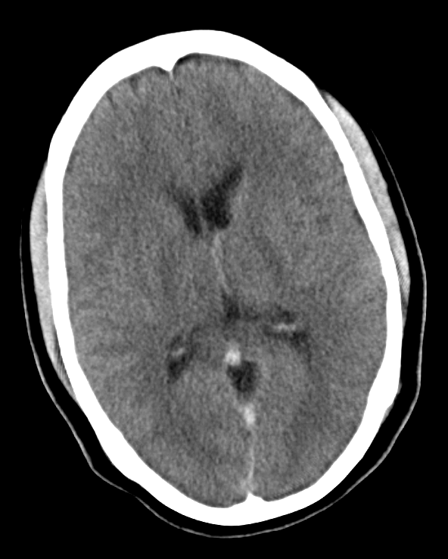
深静脉血栓: 基底静脉及直窦密度增高

Slide 21
高密度血栓占25%
？
Notes:
Increased attenuation in the venous sinuses also may be seen in patients with dehydration, an elevated hematocrit level, or a subjacent subarachnoid or subdural hemorrhage. a close comparison of sinus attenuation with arterial attenuation

Slide 22
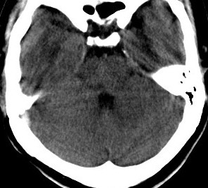
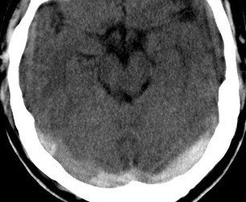
？
双侧横窦及右侧乙状窦血栓

Slide 23
右侧横窦血栓 充盈缺损

Slide 24
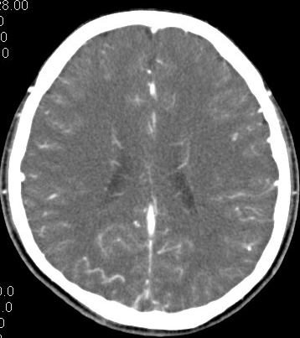
Empty delta sign

Slide 25
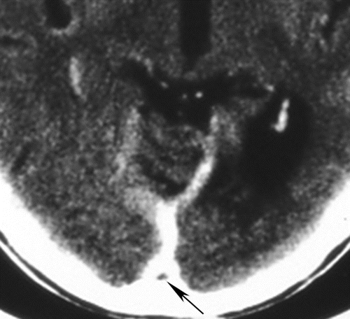
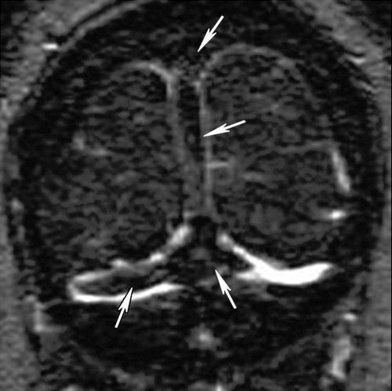

Slide 26
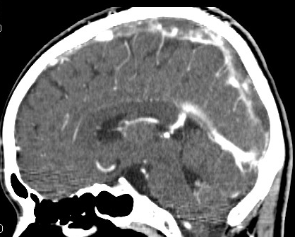
？
Notes:
周围强化说明什么？

Slide 27
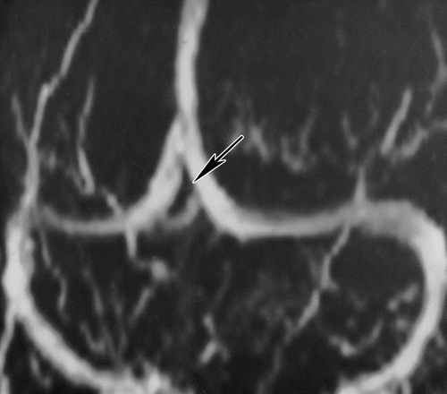
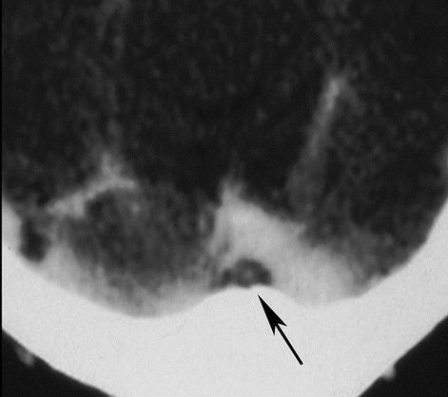
Pseudo empty delta sign

Slide 28
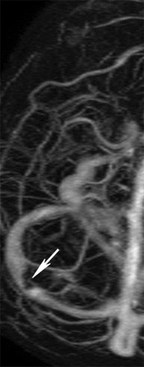
Arachnoid granulations
Notes:
they are most commonly seen in the transverse and superior sagittal sinuses on anatomic images

Slide 29
间接征像
静脉性梗死、水肿、静脉性出血

Slide 30
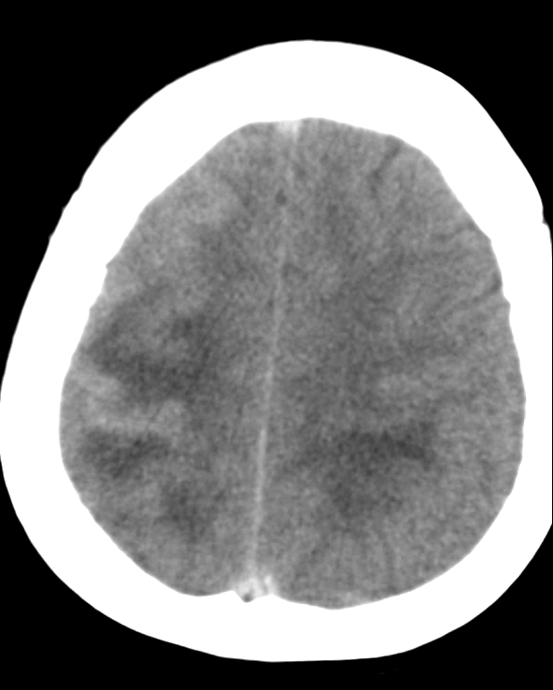
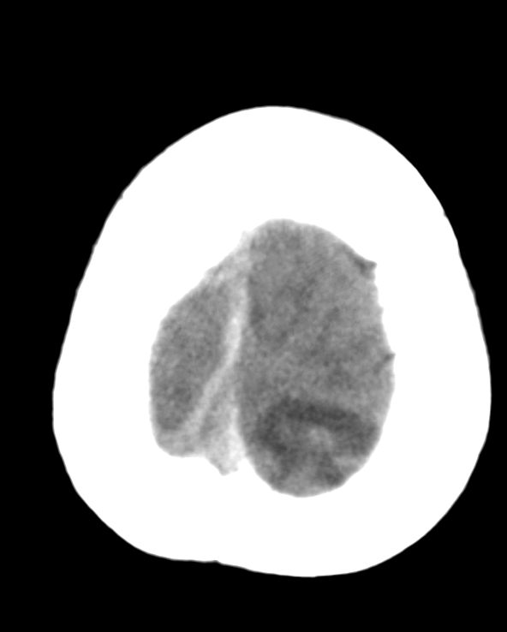

Slide 31
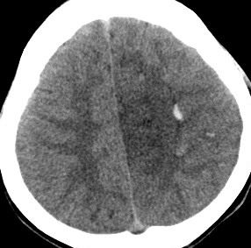
左侧额顶叶静脉性脑梗死伴静脉性脑出血

Slide 32
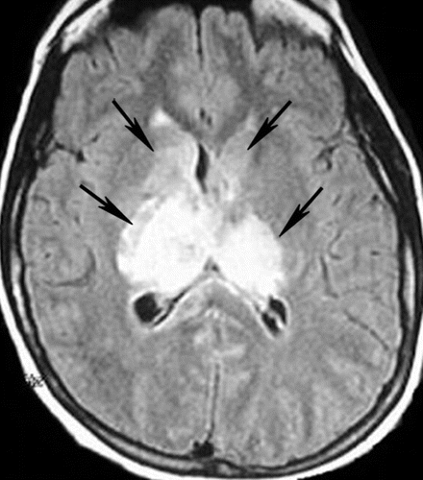
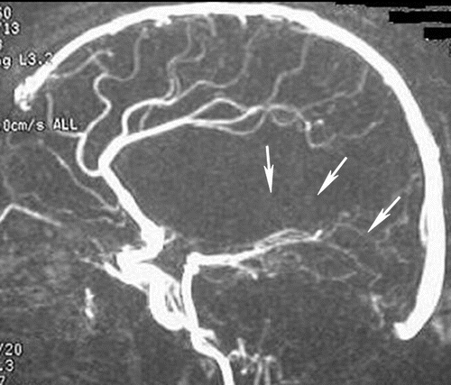

Slide 33
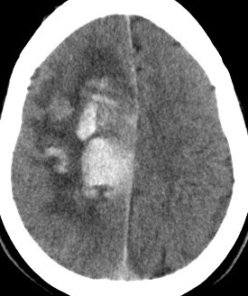
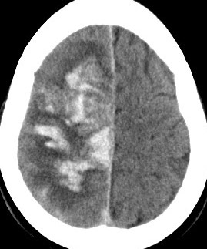
右侧额顶叶静脉性脑出血

Slide 34
动脉性脑出血

Slide 35
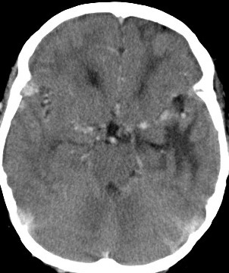
？
紫绀型心脏病（法洛氏四联症），高血红蛋白血症
Notes:
与邻近脑动脉比较

Slide 36
总 结

Slide 37
主要CT征像
直接征像：束带征（索条征）、高密度三角征； CTV见充盈缺损或空三角征
间接征像：脑肿胀；脑水肿；静脉性脑梗塞；静脉性脑出血等。

Slide 38
主要MRI征象
流空影消失（T2WI）
增强扫描：充盈缺损
MRV 静脉或静脉窦不显影

Slide 39
谢 谢 ！

