Slide 1
子宫恶性肿瘤的MRI诊断
MRI of Uterine Malignant Neoplasm
辽宁省肿瘤医院
医学影像科
Medical Image Department,
Liaoning Cancer Institute and Hospital
罗娅红
Yahong Luo
2009-8-7
Liaoning Cancer Institute and
Hospital

Slide 2
子宫恶性肿瘤的流行病学现状
Epidemiology of Uterine Malignant Neoplasm
子宫恶性肿瘤包括子宫颈癌、子宫内膜癌、滋养细
胞恶性肿瘤、子宫肉瘤等
Uterine malignant neoplasm includes cervical carcinoma, endometrial
carcinoma, uterine sarcoma and malignant trophoblastic tumor, etc.
2009-8-7
Liaoning Cancer Institute and
Hospital
2

Slide 3
子宫颈癌
Cervical Carcinoma
n
n
n
n
全球妇女恶性肿瘤发病率的第三位
The No. 3 female malignant tumor in the world
我国妇科恶性肿瘤发病率的前两位
The top two common female cancer in China
女性恶性肿瘤死亡率的第二位
The second mortality in female malignant tumor in China
每年约有3万名妇女死于宫颈癌
About 30,000 females died
2009-8-7
Liaoning Cancer Institute and
Hospital
3

Slide 4
子宫内膜癌
Endometrial carcinoma
n
n
n
全球妇女恶性肿瘤发病率的第四位
The fourth most common female cancer in the world
每年的平均病例数是30 年前的40 倍之多
The yearly average number of endometrial carcinoma is nearly
fourty times as much as those 30 years ago
随着我国妇女内分泌代谢性疾病的增加，子宫
内膜癌呈对数速度增长
With endocrinopathy morbidity rising, the number of endometrial
carcinoma is increasing according to logarithm fashion
2009-8-7
Liaoning Cancer Institute and
Hospital
4

Slide 5
子宫肉瘤
Uterine sarcoma
n
n
n
占子宫恶性肿瘤的2 % – 4 %
Accounting for 2 – 4 % of all uterine malignancies
占生殖道恶性肿瘤的1%
Accounting for 1% of all malignancies in female reproductive tract
临床罕见、恶性程度较高
A very rare and high malignancy in female reproductive tract
2009-8-7
Liaoning Cancer Institute and
Hospital
5

Slide 6
子宫恶性肿瘤的临床检查方法
Clinical examination of uterine
malignant neoplasm
2009-8-7
Liaoning Cancer Institute and
Hospital
6

Slide 7
临床检查
Clinical examination
p普通妇科检查：简单，但具有明显的局限性
Gynecological examination : simple & limited
p分期具有主观性：34％－39％的患者分期错误
Subjectivity on its staging: 34%-39% of incorrect staging
p不能全面评价肿瘤侵犯深度和盆腔淋巴结转移
Difficult to identify invasive extent and lymph node metastases
2009-8-7
Liaoning Cancer Institute and
Hospital
7

Slide 8
临床检查-细胞学检查
Clinical examination-Exfoliative cytologic examination
n检测来源于子宫内膜、子宫颈的恶性细胞
Finding malignant cells from cervix and uterine endometrium
n为子宫恶性肿瘤的诊断诊断提供直接依据
Providing direct diagnosis for uterine malignant neoplasm
n为子宫微生物感染提供诊断依据
Finding foundation for uterine microbial infection
n在肿瘤的分期上无明显价值
No value on its staging
2009-8-7
Liaoning Cancer Institute and
Hospital
8

Slide 9
临床检查-阴道宫腔镜
Clinical examination-- hysteroscopy
n
n
n
对子宫可疑病变进行定位活检
Biopsy for suspected lesion
明显提高子宫体、颈部早期癌的诊断率
Higher diagnostic rate of uterine and cervical cancer
不能客观评价肿瘤侵犯深度和盆腔淋巴结转移
Unable to evaluate invasive extent and lymphnodes metastasis
accurately
2009-8-7
Liaoning Cancer Institute and
Hospital
9

Slide 10
影像学方法-超声检查
Medical image examination-Ultrasonography
p
p
p
对子宫可疑病变进行定位活检
The most common screen on uterine malignant tumor
经腹超声在分期上应用价值较小
Trans-abdominal ultrasound with few value on staging
阴式超声可明显提高子宫恶性肿瘤的分期，
其阳性、阴性预测值分别约62％和92％
Improving staging by trans-vagina ultrasound with 62% for
positive predictive value and 92% for negative predictive value
2009-8-7
Liaoning Cancer Institute and
Hospital
10

Slide 11
影像学方法- CT检查
Medical image examination-CT
n
n
n
平扫CT：子宫恶性肿瘤与子宫壁密度相似，难以显
示癌肿的浸润深度和范围
Non-CE CT: difficult to show tumor invasive depth and extent because
of similar intensity between uterine tissues & malignant tissues
CT增强：子宫恶性肿瘤显示有局限性
Showing uterine disease with some limitations by CE CT
CT评价宫旁浸润假阳性较高，准确度仅33％－58％
Accuracy is 33％－58％ on evaluating parametrical invasion by CT
because of a high false-positive error
2009-8-7
Liaoning Cancer Institute and
Hospital
11

Slide 12
影像学方法- MR
Medical image examination--MRI
n
n
上世纪80年代，MRI出现并应用于子宫肿瘤的诊断
MRI used in uterine diagnosis in the last 80's
当时，成像时间长、图像易受呼吸、血管搏动和肠
蠕动的影响、磁场强度低等缺点使其应用受限
At that time, longer imaging time & imaging quality easily disturbed by
breath, vessel pause, bowel movement, low magnetic field strengt, etc.
These disadvantages limited its application
2009-8-7
Liaoning Cancer Institute and
Hospital
12

Slide 13
n
n
随着MRI场强、梯度切换率的提高和多通道高
密相控阵线圈的应用，使应用MRI技术对子宫
恶性肿瘤进行准确诊断和客观评价成为可能
With high-magnetic MR scanner,high-gradient switch ratio and
multiple phased array coils, it is possible to diagnose uterine
malignacy accurately and evaluate it objectively by MRI
MRI因其极高的软组织分辨力，能够清晰显示
子宫的组织结构和信号的细微变化，近而准确
评价子宫恶性肿瘤的大小和范围
Clearly displaying uterine layers, signal changes, tumor size and
extent on MRI image because of it high soft tissue resolution
2009-8-7
Liaoning Cancer Institute and
Hospital
13

Slide 14
n
n
肿瘤分期达到Ⅰb期以上，MRI的评价准确性、阳性
和阴性预测值分别可达81％－ 95%、100％、90%
Above IB staging, accuracy, positive predictive value and negative
predictive value of MRI evaluation : 81%-95%,100% and 90%
在显示子宫恶性肿瘤宫旁浸润和淋巴结转移等方
面，其敏感度、特异度均较高
High sensitivity and specificity in showing parametrical invasion and
lympnode metastasis from uterine malignant neoplasm on MRI
2009-8-7
Liaoning Cancer Institute and
Hospital
14

Slide 15
影像学方法- PETCT检查
Medical image examination-PEC/CT
n
n
n
是评价子宫肿瘤良恶性的最佳影像方法之一
One of the best evaluations on uterine malignancy
对肿瘤及周围淋巴结转移进行客观评价，其特
异性高，阳性预测值约75%-100%
Objective view on tumor and lymph node metastasis with 75%-
100% positive predictive value
昂贵的价格制约了其广泛应用
Application limited by expensive costing
2009-8-7
Liaoning Cancer Institute and
Hospital
15

Slide 16
MRI在子宫恶性肿瘤诊断上的价值
Diagnostic Value of MRI in Uterine
Malignant Neoplasm
2009-8-7
Liaoning Cancer Institute and
Hospital
16

Slide 17
MRI成像的优势
Advantage of MRI
n
n
n
n
无损伤和辐射性
No injury and radiation
高的软组织分辨力和极高的敏感度
High soft tissue resolution and sensitivity
MRI三维成像使病灶定位更准确
3D images with high accuracy in lesions
检出子宫多灶性病变以及评价侵犯的范围、
周围淋巴结转移区域有明显价值
Identifying multiple lesions,invasive extending and lymph node
metastasis
2009-8-7
Liaoning Cancer Institute and
Hospital
17

Slide 18
n
n
动态增强检查可了解病变的血流灌注情况,有助于
病变性质的评价
Exploring perfusion & evaluation of tumors by DCT
为准确分期和临床治疗方案的制定提供可靠依据
Providing accurate staging and therapy planning
2009-8-7
Liaoning Cancer Institute and
Hospital
18

Slide 19
子宫MRI检查的适应症
Indications of uterine MRI examination
n
n
n
n
n
检出子宫隐匿性病灶、囊性病灶及多灶性病变
Detecting occult, cystic and multiple lesions
评价子宫恶性肿瘤的浸润范围和淋巴结转移
Evaluating invasive extent and lympnode metastasis
评价子宫恶性肿瘤的新辅助治疗疗效
Evaluateing therapy effect
确定手术适应症
Determining surgical indications
监测子宫恶性肿瘤的术后复发
Monitoring post-surgical recurrence
2009-8-7
Liaoning Cancer Institute and
Hospital
19

Slide 20
子宫恶性肿瘤的MRI诊断、分期
Diagnosing and Staging of Uterine
Malignant Neoplasm by MRI
2009-8-7
Liaoning Cancer Institute and
Hospital
20

Slide 21
（一）子宫内膜癌
Endometrial Carcinoma
2009-8-7
Liaoning Cancer Institute and
Hospital
21

Slide 22
子宫内膜癌的临床特征
Clinical Characters of Endometrial Carcinoma
n
n
临床表现：绝经后妇女阴道不规则流血、
恶臭液体及烂肉,下腹疼痛、消瘦和贫血
Clinical manifestations: postmenopausal women with
irregular vaginal bleeding, foul liquid,necrotic tissue,
abdominal pain, weight loss and anemia
好发部位：子宫底和体后壁
Occurrence sites: the posterior wall of uterus and its
bottom
2009-8-7
Liaoning Cancer Institute and
Hospital
22

Slide 23
扩散方式
The spreading ways
Ø
Ø
Ø
直接播散
Direct spreading
淋巴转移
Lymph node metastasis
血行转移
Hematogenous metastasis
2009-8-7
Liaoning Cancer Institute and
Hospital
23

Slide 24
子宫内膜癌的MRI特征
MRI Characters of Endometrial Carcinoma
病变局限于内膜
Lesions confined in endometrial
n
n
n
T1WI：癌肿信号稍低于内膜或与肌层信号一致
T1WI: endometrial carcinoma signal is slightly lower than the
endometrial signal or same as the myometrial signal
T2WI：内膜局限/弥漫增厚，呈稍高信号
T2WI: hyper-signal in limitations / diffuse thickening endometrial
病变不强化或轻度强化，低于肌层
Slightly or no enhanced contrast with a signal lower than myometrial
2009-8-7
Liaoning Cancer Institute and
Hospital
24

Slide 25
病变侵入肌层
Invading myometrial
n
n
n
癌肿呈菜花状、息肉状突入宫腔
lesions with cauliflower-like mass in the uterine cavity
T2WI:低信号的结合带内出现高信号
T2WI: hyper-signal in lower junctional zone
增强时:肌层病变与内膜病变均呈低信号，强化的
结合带不完整
CE: lesion with low signals in both myometrial and endometrial
layers, showing incompletely enhanced changes in the junctional
zone
2009-8-7
Liaoning Cancer Institute and
Hospital
25

Slide 26
深肌层受侵
Deep myometrial invasion
n
n
子宫各层结构消失, 局部肌层出现不规则低信号
病灶，肌层变薄
Disappearance uterine layers with focused, irregular low-signal
lesions in myometrium & thinning myometrium
子宫增大, 盆腔内组织器官广泛受侵
Enlarged uterus, diffusion involvement in pelvic tissues & organs
2009-8-7
Liaoning Cancer Institute and
Hospital
26

Slide 27
子宫内膜癌的临床分期
Staging of Endometrial Carcinoma
采用国际妇产科联盟分期标准
From International Federation of Gynecology and Obstetrics, FIGO
n
n
n
n
Ⅰa:肿瘤仅局限于子宫内膜
Ⅰa :Tumor confined in endometrium
Ⅰb:子宫肌层受侵小于1/2
Ⅰb: invaded myometrial less than 1/2
Ⅰc:子宫肌层受侵大于1/2
Ⅰc: invased myometrial more than1/2
Ⅱa:宫颈内膜受侵
Ⅱa: invasion into cervical endometrial
2009-8-7
Liaoning Cancer Institute and
Hospital
27

Slide 28
n
n
n
n
n
n
Ⅱb:肿瘤侵犯到宫颈基质外
Ⅱb: invasion into cervical stromal outside
Ⅲa:附件受侵或穿出浆膜/腹腔积液细胞学(＋)
Ⅲa: out of the annex or serosal invasion/peritoneal fluid cytology (+)
Ⅲb:阴道扩散
Ⅲb: the spread of the vagina
Ⅲc:盆腔或主动脉周围淋巴结转移
Ⅲc: pelvic lymph node metastasis around the aorta
Ⅳa期:膀胱或直肠受侵
Ⅳa: involvement of bladder or rectum
Ⅳb期:远处转移或腹部、腹股沟淋巴结转移
Ⅳb: distant metastasis or the abdomen, groin lymphnode metastasis
2009-8-7
Liaoning Cancer Institute and
Hospital
28

Slide 29
2009-8-7
Liaoning Cancer Institute and
Hospital
29

Slide 30
2009-8-7
Liaoning Cancer Institute and
Hospital
30

Slide 31
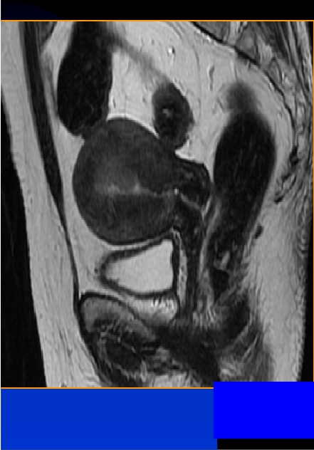
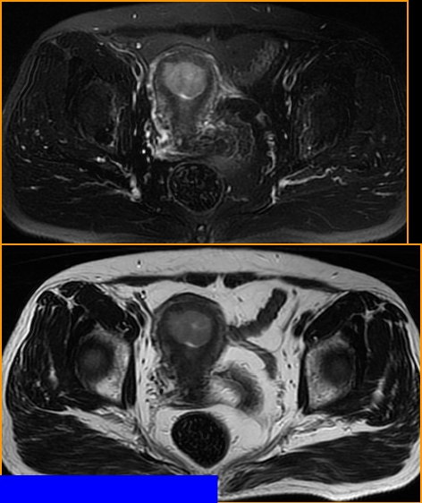
子宫内膜癌Ib 期 55岁
--StageⅠb endometrial carcinoma in a 55-year-old woman
T2WI
T2WI
T1WI
肌层受侵小于 Cancer Institute and
1/2
Liaoning
Invaded myometrial less than 1/2
2009-8-7
Hospital
31

Slide 32
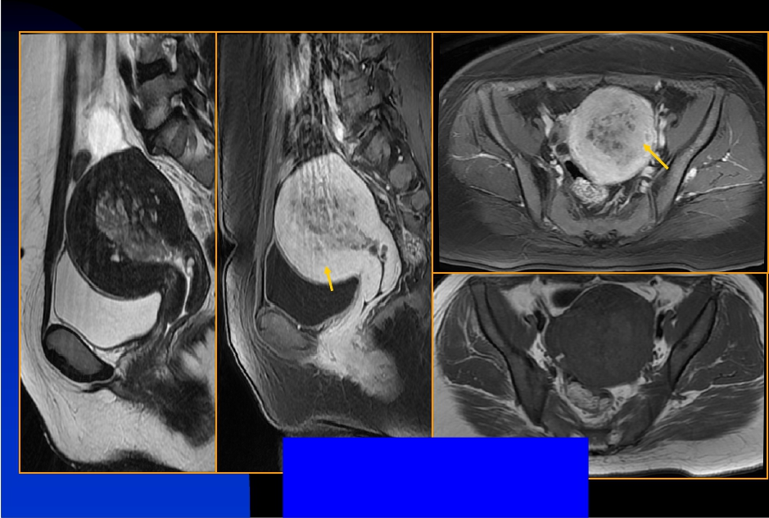
子宫内膜癌Ic期 40岁
--Stage Ic endometrial carcinoma in a 40-year-old woman
CE: T1WI
T2WI
2009-8-7
CE: T1WI
肌层受侵大于1/2
Liaoning Cancer Institute and
Hospital
T1WI
32
Invased myometrial more than1/2

Slide 33
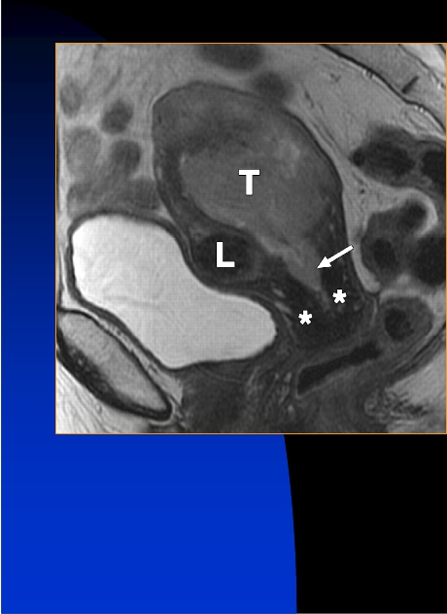
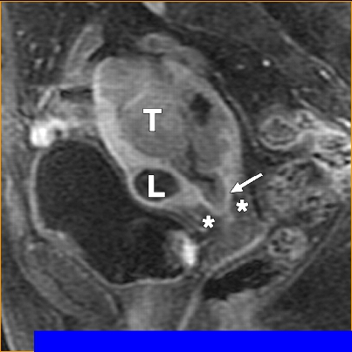
子宫内膜癌IIa期 78岁
----Stage IIa endometrial carcinoma in a 78-year-old woman
T2WI
T2WI
宫颈内膜受侵
Invasion into cervical endometrial
Sala, E. et al. Am. J. Roentgenol. 2007;188:1577-1587
2009-8-7
Copyright © 2007 by the American Roentgen Ray Society
Liaoning Cancer Institute and
Hospital
33

Slide 34
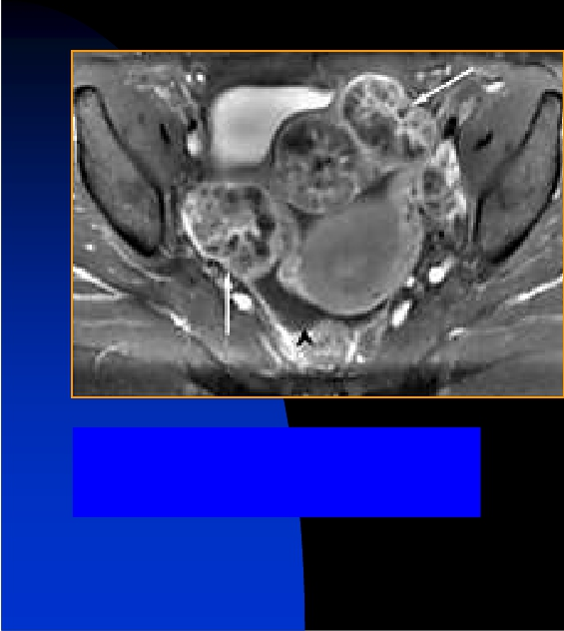
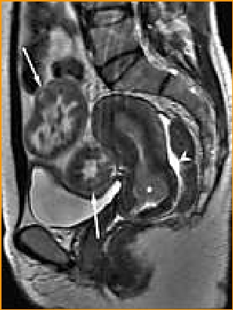
子宫内膜癌Ⅲa期
----Stage Ⅲa endometrial carcinoma
T2WI
T2WI
双侧卵巢受侵
tumor invading the ovaries
http://imaging.consult.com
2009-8-7
Liaoning Cancer Institute and
Hospital
34

Slide 35
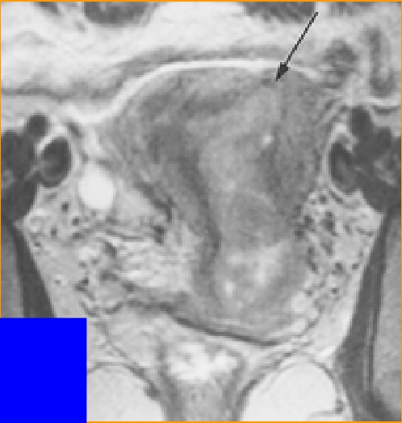
子宫内膜癌Ⅲb期
----Stage Ⅲb endometrial carcinoma
肌层受侵大于1/2伴阴道扩散
Deep invasion >50% of the myometrial
thickness of endometrial carcinoma
(arrow).The spread of the vagina
2009-8-7
T2WI
Liaoning Cancer Institute and
Hospital
35

Slide 36
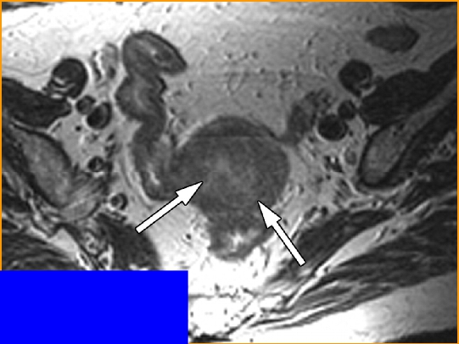
子宫内膜癌Ⅲc期
----Stage Ⅲc endometrial carcinoma
肌层受侵大于1/2伴闭孔内淋巴结转移
Deep invasion >50% of the myometrial
thickness of endometrial carcinoma (arrow)
and internal obturator lymph node metastasis
T2WI
Radiology 2004 18 ( 10).1148
Riccardo et.al
2009-8-7
Liaoning Cancer Institute and
Hospital
36

Slide 37
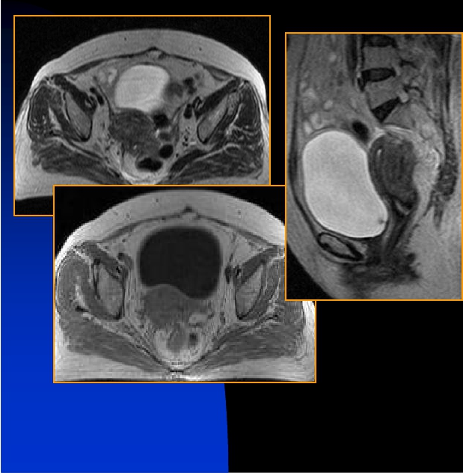
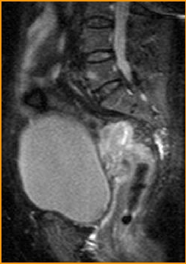
子宫内膜癌Ⅳa期
----Stage Ⅳa endometrial carcinoma
T2WI
T2WI
T2WI
直肠受侵
Involvement of rectum
T1WI
2009-8-7
Liaoning Cancer Institute and
Hospital
37

Slide 38
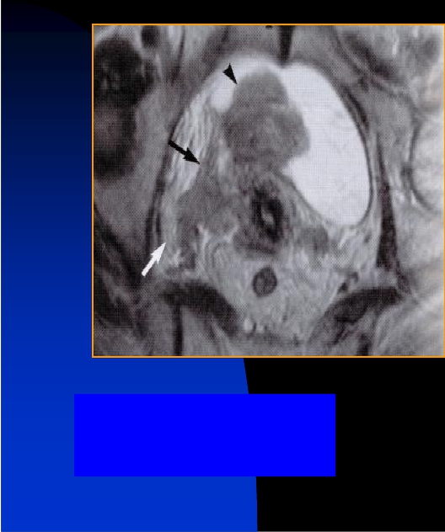
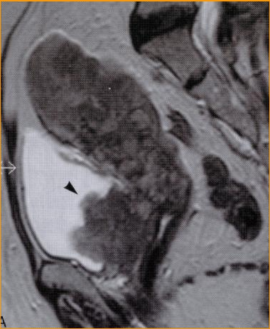
子宫内膜癌Ⅳa期
----Stage Ⅳa endometrial carcinoma
T2WI
T2WI
膀胱受侵
Involvement of bladder
Jpn Clinica lRadol 50（11）1514-1515
2009-8-7
Liaoning Cancer Institute and
Hospital
38

Slide 39
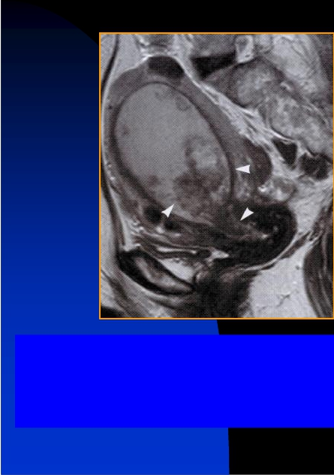
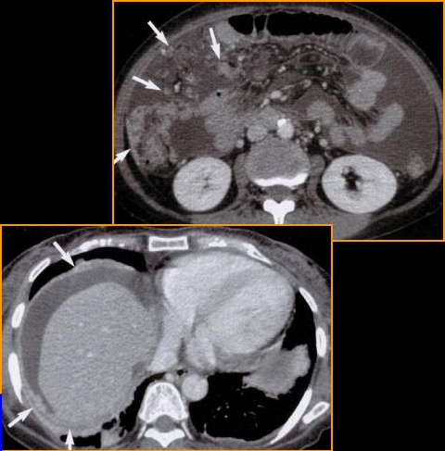
子宫内膜癌Ⅳb期
----Stage Ⅳb endometrial carcinoma
宫颈受侵、腹部多发转移
Invasion into cervical and abdomen
metastasis
2009-8-7
Liaoning Cancer Institute and
Hospital
39

Slide 40
（二）子宫颈癌
Cervical carcinoma
2009-8-7
Liaoning Cancer Institute and
Hospital
40

Slide 41
子宫颈癌的临床特征
Clinical Characters of Cervical Carcinoma
n
n
n
病因:尚不清，可能与妇女性生活、生育史、生殖道病
毒或细菌感染、性病、种族、地理和营养状况等相关
Etiology: not clearly, maybe related with sexual life, reproductive history,
reproductive tract virus or bacterial infection, sexually transmitted
diseases, race, geography and nutrition
肿瘤来源:95%为宫颈鳞状上皮；5%为宫颈管腺上皮
Oncology resource : 95% from cervical squamous cell; 5% from the
cervical epithelium
好发部位：鳞状上皮和柱状上皮间的移行区
Ocurrence site: transitional zone between squamous epithelium and
columnar epithelium
2009-8-7
Liaoning Cancer Institute and
Hospital
41

Slide 42
n
n
临床表现：阴道出血是主要征象，可以是自然出
血或接触性出血，合并感染时白带增多
Clinical : the main symptom : vaginal bleeding with natural or contact
bleeding, white discharge infection
扩散方式：深部浸润、直接蔓延、淋巴转移，血
行转移少
The spreading: deep infiltration, direct spreading, lymph node
metastasis, hematogenous metastasis
2009-8-7
Liaoning Cancer Institute and
Hospital
42

Slide 43
子宫颈癌的临床分期
Staging of Cervical Carcinoma
采用国际妇产科联盟分期标准
From International Federation of Gynecology and Obstetrics, FIGO
n
Ⅰ期：限于宫颈
Stage Ⅰ – confined to the cervix
ØⅠa:早期镜下浸润
Ⅰa - Diagnosed only by microscopy; no visible lesions
Ø
Ø
Ⅰa1期:微灶浸润深度小于3mm,宽度小于7mm
Ⅰa1 - stromal invasion less than 3 mm in depth and
7 mm or less in horizontal spread
Ⅰa2期:融合性浸润，深度在3-5mm，宽度＜7mm
Ⅰa2 - stromal invasion between 3 and 5 mm with
horizontal spread of 7 mm or less
Liaoning Cancer Institute and
2009-8-7
Hospital
43

Slide 44
Ø
Ø
Ø
Ⅰb期：浸润深度>5mm，宽度>7mm
Ⅰb - visible lesion or a microscopic lesion with more than 5 mm of
depth or horizontal spread of more than 7 mm
Ⅰb1期：病灶可视最大径<40mm
Ⅰb1 - visible lesion 4 cm or less in greatest dimension
Ⅰb2期：病灶可视最大径>40mm
Ⅰb2 - visible lesion more than 4 cm
n
Ⅱ期：癌灶超越宫颈
Stage Ⅱ – involved in cervix
Ø
Ø
Ⅱa:癌肿未达到骨盆壁，累及阴道上部2/3
Ⅱa – no parametrial invasion, but involved in upper 2/3 of vagina
Ⅱb:宫颈旁组织浸润
Ⅱb - parametrial invasion
2009-8-7
Liaoning Cancer Institute and
Hospital
44

Slide 45
n
Ⅲ期：癌肿累及阴道下1/3和/或达到骨盆壁
Stage III - extends to pelvic wall or lower third of the vagina
Ø
Ø
Ⅲa期：癌肿累及阴道下1/3
Ⅲa - involves lower 1/3 of vagina
Ⅲb期：骨盆壁累和/或肾盂积水或无功能肾
ⅢB - extends to pelvic wall and/or causes hydronephrosis or non-
functioning kidney
n
Ⅳ期：癌肿累及真骨盆以外部分或累及膀胱或直肠
(Ⅳa)，到达远处器官(Ⅳb)
Ø
Ø
Ⅳa - invades mucosa of bladder or rectum and/or extends beyond true
pelvis
Ⅳb - distant metastasis
2009-8-7
Liaoning Cancer Institute and
Hospital
45

Slide 46
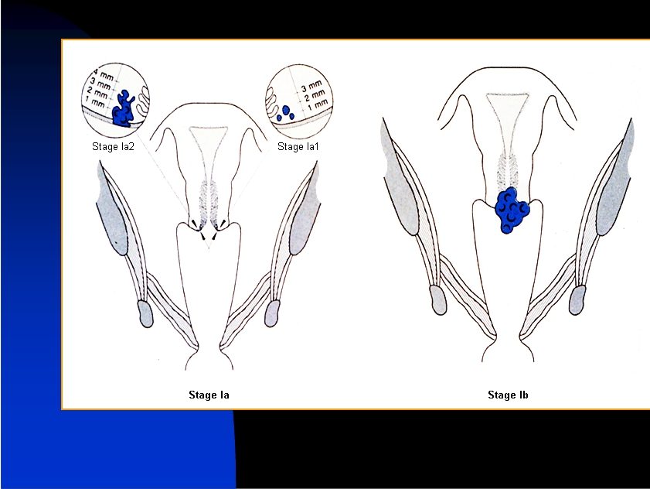
2009-8-7
Liaoning Cancer Institute and
Hospital
46

Slide 47
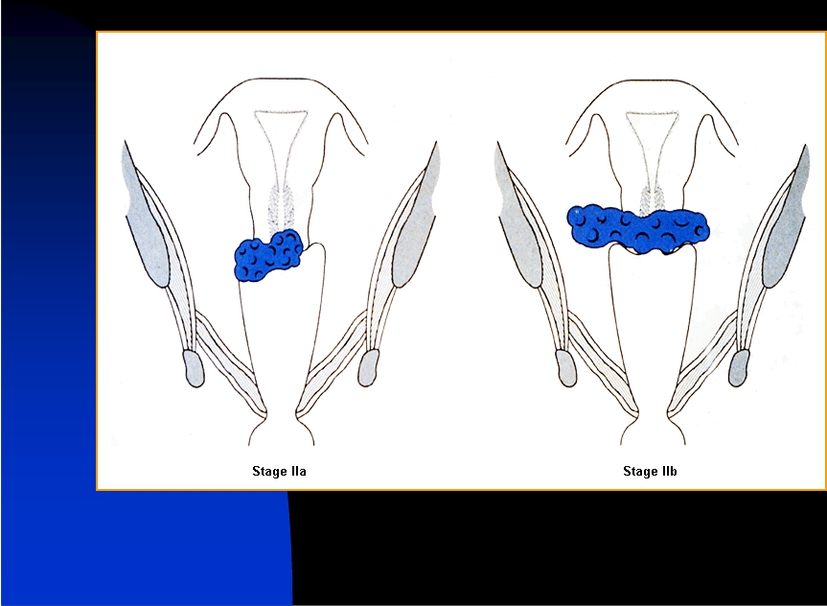
2009-8-7
Liaoning Cancer Institute and
Hospital
47

Slide 48
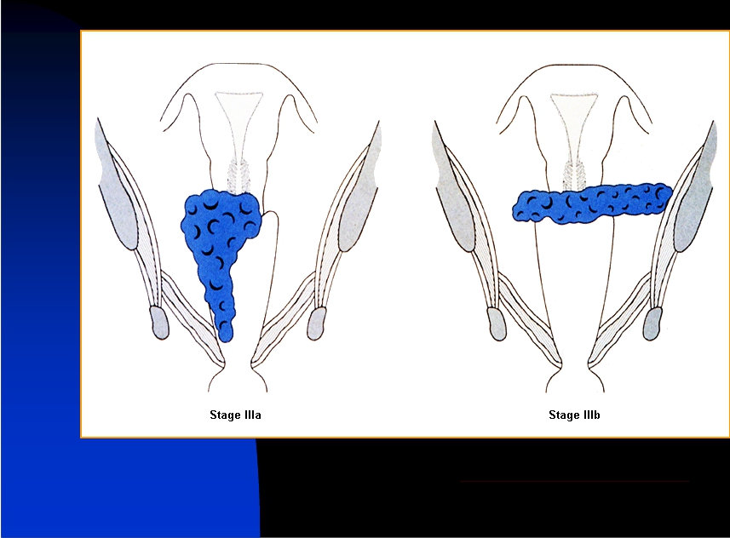
bestpractice.bmj.com/best-practi...
2009-8-7
Liaoning Cancer Institute and
Hospital
48

Slide 49
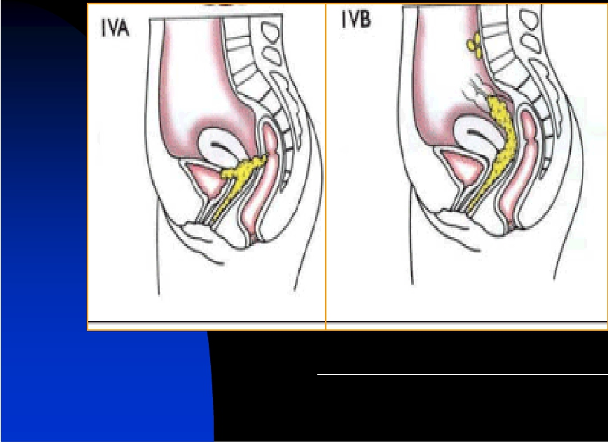
http://www.scielo.br/scielo.php?script=sci_arttext&pid=S0100 -
39842007000300014&tlng=en&lng=en&nrm=iso
2009-8-7
Liaoning Cancer Institute and
Hospital
49

Slide 50
子宫颈癌的MRI特征
MRI Characters of Cervical Carcinoma
癌肿的MRI表现
MRI Characters of lesion
n
n
n
MRI轴位上显示为类圆形和不规则形分叶肿块
MRI: a round, irregular-shaped and lobulated mass on axial MRI
矢状位显示宫颈增大为桶状，宫颈管腔消失
Enlarged cervix with barrel shape on sgaiggtal imaging
T1WI呈等信号，T2WI呈高信号
the disappearance of cervical cannel iso-signal on T1WI; hyper-
signal on T2WI
2009-8-7
Liaoning Cancer Institute and
Hospital
50

Slide 51
n
n
T2WI:癌肿与正常宫颈基质低信号及宫旁脂肪
间隙有良好对比
T2WI: good contrast between the tumor and normal cervical
stroma with low signal & parametrial space
增强动态扫描，T1WI癌肿早期强化，可清晰
显示病灶的形态、边界和宫颈基质受侵犯的
深度
CE: obviously showing enhanced tumor with shape and rim
and the depth of cervical stromal invasion
2009-8-7
Liaoning Cancer Institute and
Hospital
51

Slide 52
癌肿侵犯深度的MRI评价
Tumor invasion depth: evaluation by MRI
n
n
局限于粘膜内：浸润深度＜5mm，T1WI与T2WI呈中等
信号，与正常粘膜接近;增强扫描可依据早期强化的癌
肿清晰显示病灶的边缘及其浸润的深度
Confined in mucosa: the invasion depth <5mm; iso-signal on T1WI and
T2WI, showing similar signal with nearly normal mucosa and enhanced
lesion with clear rim and invasive depth on contrast-enhanced image
病变侵犯基质：T2WI低信号的基质环被癌肿高信号部
分或完全取代时，即使外缘光整，也提示基质受侵
Invaded stroma by lesion: hypo-signal on T2WI replaced by tumor as a
smooth rim, demonstrating a complete or partial damage in cervical
stroma
2009-8-7
Liaoning Cancer Institute and
Hospital
52

Slide 53
n
n
病变侵犯宫体：T2WI子宫体增大，低信号的结
合带被高信号的癌肿组织取代/内外带显著不规
则
Invaded uterine corpus by lesion: enlarged uterus corpus on T2WI,
junctional zone replaced by hyper-signal of tumor, showing
irregular changes on hypo-signal of inner and latter zone
病变侵犯宫旁：T1WI双侧宫旁不对称，宫颈外
缘不规则，低信号的宫旁组织出现稍高信号肿
块；增强后，肿块明显强化
T1WI:invaded uterine corpus by lesion, showing unsymmetrical
parametrial changes and irregular rim on cervix with hyper-signal
mass with clear enhancement in hypo-signal parametrial tissue
2009-8-7
Liaoning Cancer Institute and
Hospital
53

Slide 54
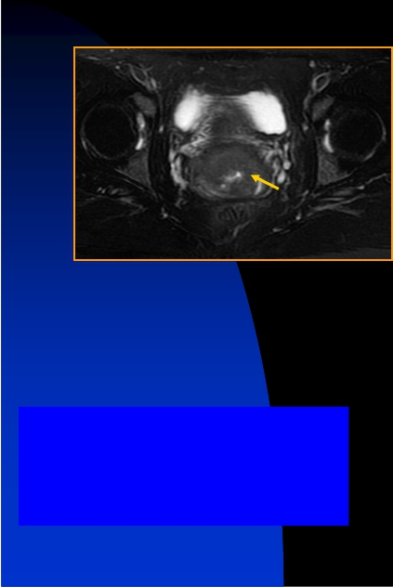
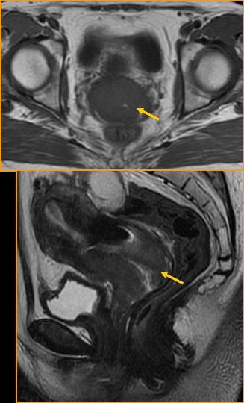
子宫颈癌Ib期 36岁
----Stage Ⅰb cervical carcinoma in a 36-year-old woman
T2WI
浸润深度>5mm，宽度>7mm
Stromal invasion more than
5 mm in depth and more
than7 mm in horizontal spread
T1WI
T2WI
2009-8-7
Liaoning Cancer Institute and
Hospital
54

Slide 55
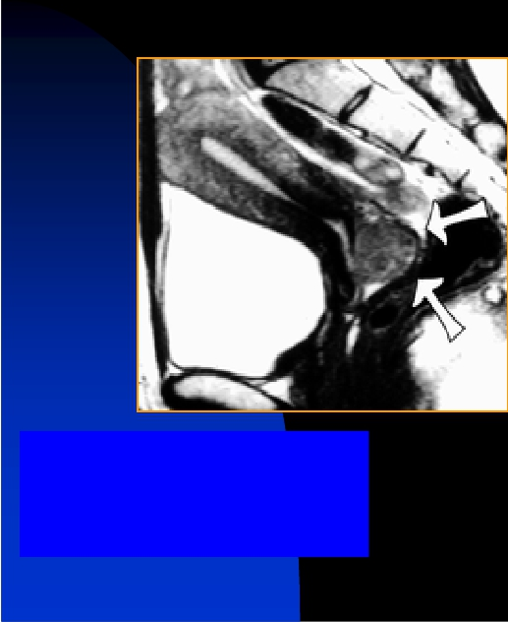
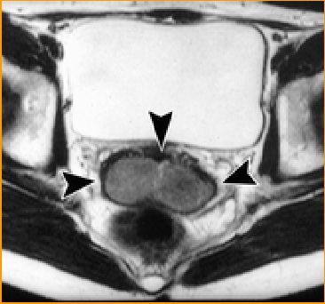
子宫颈癌Ib期
----Stage Ⅰb cervical carcinoma
T2WI
浸润深度>5mm，宽度>7mm
Stromal invasion more than
5 mm in depth and more
than7 mm in horizontal spread
T2WI
2009-8-7
Liaoning Cancer Institute and
Hospital
55

Slide 56
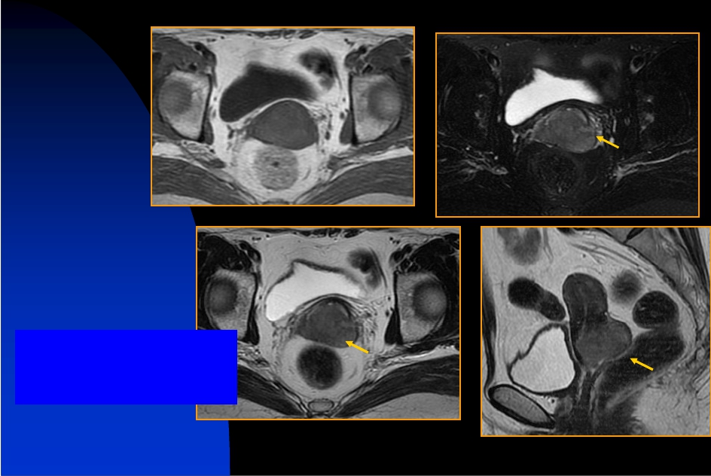
子宫颈癌Ⅱa期 34岁
----Stage Ⅱa cervical carcinoma in a 34-year-old woman
T1WI
T2WI
癌肿累及阴道上部2/3
involved in upper 2/3 of
vagina
T2WI
T2WI
2009-8-7
Liaoning Cancer Institute and
Hospital
56

Slide 57
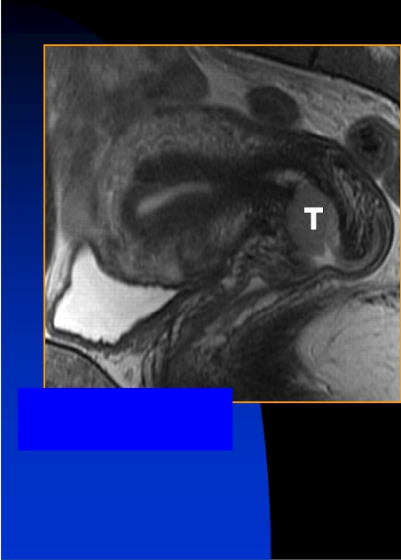
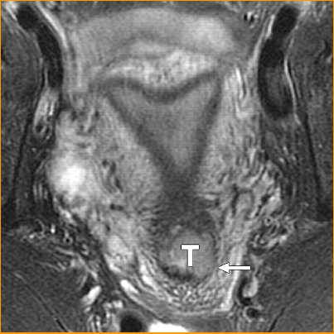
子宫颈癌Ⅱb期 47岁
----Stage Ⅱb cervical carcinoma in a 47-year-old woman
T2WI
T2WI
Sala, E. et al. Am. J. Roentgenol. 2007;188:1577-1587
宫颈旁组织浸润
parametrial invasion
2009-8-7
Liaoning Cancer Institute and
Hospital
57

Slide 58
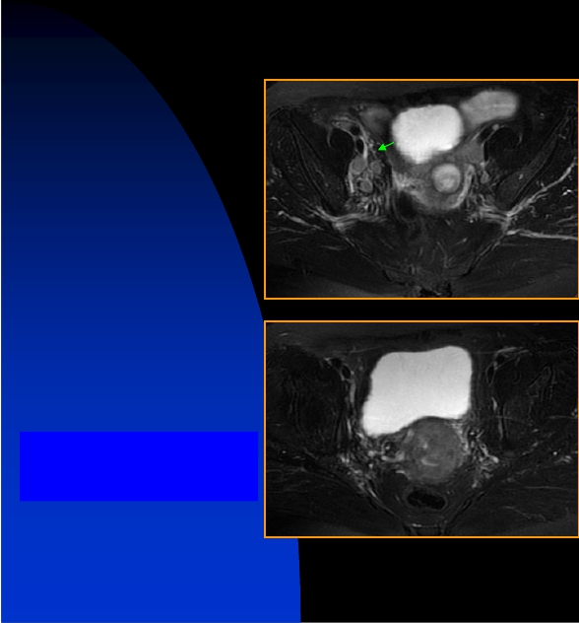
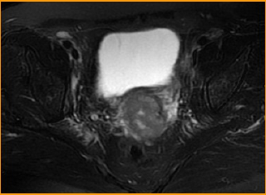
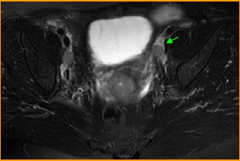
子宫颈癌Ⅱb期
----Stage Ⅱb cervical carcinoma
T2WI
T2WI
宫颈旁组织浸润
parametrial invasion
2009-8-7
T2WI
T2WI
Liaoning Cancer Institute and
Hospital
58

Slide 59
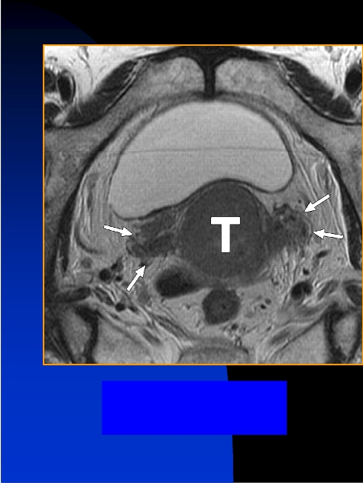
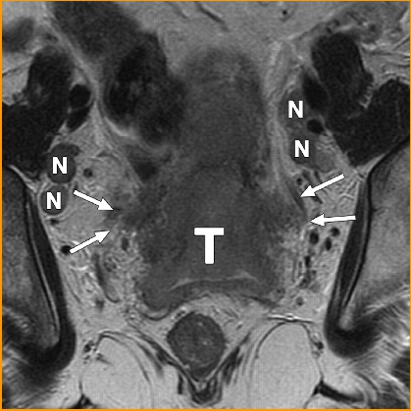
子宫颈癌IIb期 42岁
--Stage IIb cervical cancer in 42-year-old woman
T2WI
宫颈旁组织浸润
parametrial invasion
T2WI
Sala, E. et al. Am. J. Roentgenol. 2007;188:1577-1587
2009-8-7
Copyright © 2007 by the American Roentgen Ray Society
Liaoning Cancer Institute and
Hospital
59

Slide 60
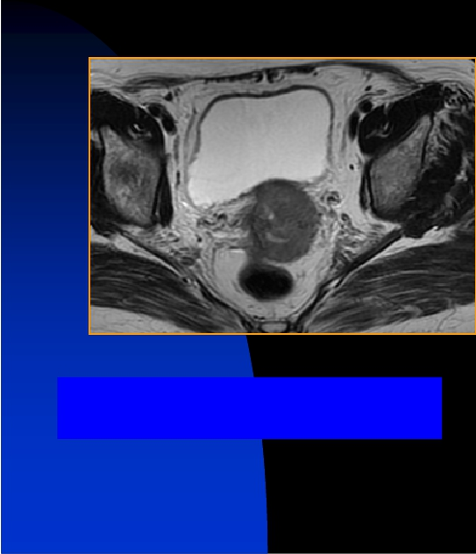
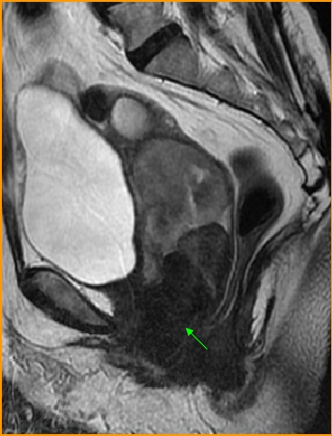
子宫颈癌IIIa期 45岁
--Stage Ⅲa cervical cancer in 45-year-old woman
T2WI
累及阴道下1/3
extends to the lower 1/3 of vagina
T2WI
2009-8-7
Liaoning Cancer Institute and
Hospital
60

Slide 61
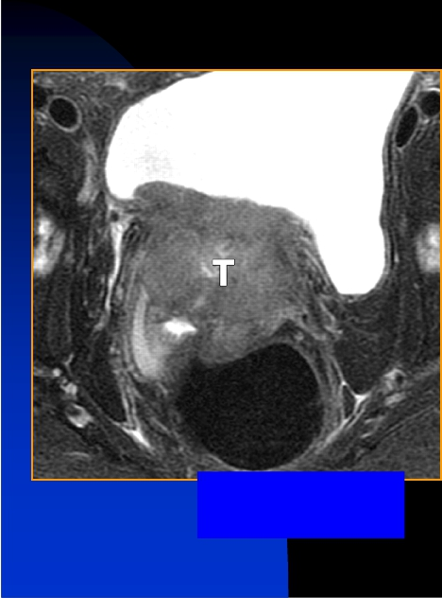
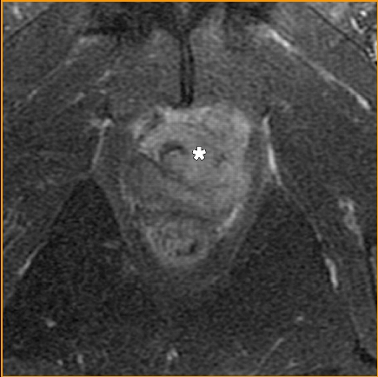
子宫颈癌IVa期 39岁
--Stage Ⅳa cervical cancer in 39-year-old woman
T2WI
累及直肠
extends to rectum
T2WI
Sala, E. et al. Am. J. Roentgenol. 2007;188:1577-1587
2009-8-7
Liaoning Cancer Institute and
Hospital
61

Slide 62
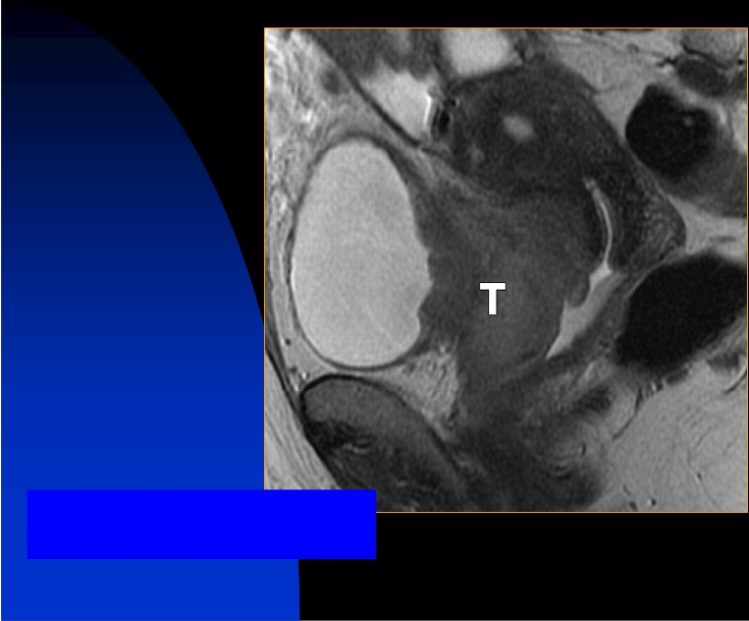
子宫颈癌IVa期
--Stage Ⅳa cervical cancer
T2WI
Sala, E. et al. Am. J. Roentgenol. 2007;188:1577-1587
累及膀胱
extends to rectum and bladder
2009-8-7
Copyright © 2007 by the American Roentgen Ray Society
Liaoning Cancer Institute and
Hospital
62

Slide 63
（三）子宫肉瘤
Uterine Sarcoma
2009-8-7
Liaoning Cancer Institute and
Hospital
63

Slide 64
子宫肉瘤的临床特征
Clinical Characters of Uterine Sarcoma
n
n
n
病因：尚不清
Etiology: unclear
肿瘤来源:子宫平滑肌、子宫内膜间质、血管、纤维组织
Oncology Source: uterine smooth muscle, endometrial stromal, vascular,
fibrous tissues
病理分类：子宫平滑肌肉瘤、子宫内膜间质肉瘤、混合
型同源mullerian肉瘤、混合型异源mullerian肉瘤
Pathological classification: uterine leiomyosarcoma, endometrial stromal
sarcoma, homologous mixed mullerian sarcoma, mixed mullerian
heterologous sarcoma
2009-8-7
Liaoning Cancer Institute and
Hospital
64

Slide 65
临床表现
Clinical manifestations
n
n
n
n
最常见症状不规则阴道出血
Common symptoms-- irregular vaginal bleeding
肿瘤生长过快、过度膨胀或瘤内出血坏死
Excessive tumor growth, excessive swelling or bleeding and
necrosis
腹痛及肿瘤的压迫症状
Symptoms of oppression and pain
触及腹部包块
Palpable abdominal mass
2009-8-7
Liaoning Cancer Institute and
Hospital
65

Slide 66
n
n
生长方式：多数为弥漫性生长，与肌层分界不
清，无包膜
Growth : the majority of them having diffuse growth with unclear
boundaries between muscular and tumor and without envelope
扩散方式：直接侵犯、淋巴转移、血行转移
Spreading: direct invasion,lymphatic metastasis, hematogenous
metastasis
2009-8-7
Liaoning Cancer Institute and
Hospital
66

Slide 67
子宫肉瘤的MRI特征
MRI Characters of Uterine Sarcoma
n
n
n
n
子宫肉瘤的MRI表现无特异性
No specific findings on MRI of uterine sarcoma
子宫肉瘤较之其它肿瘤，体积一般较大
Compared with other tumors, generally having larger volume
子宫肉瘤常出血、囊变，导致癌肿信号混杂
Frequent hemorrhage and cystic degeneration with mixed-signal
子宫肉瘤发生深部肌内膜浸润和腹腔种植转移
的几率较高
Uterine sarcoma with higher probability of endometrial deep
muscle invasion and peritoneal metastasis
2009-8-7
Liaoning Cancer Institute and
Hospital
67

Slide 68
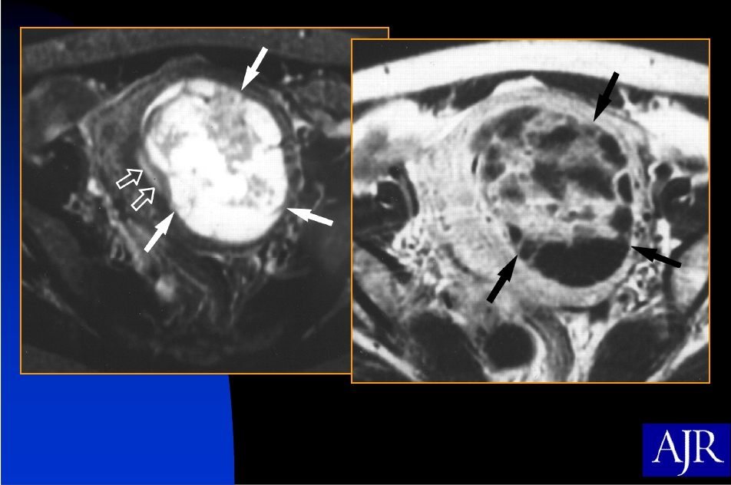
子宫肉瘤 42岁
--Low-grade endometrial stromal sarcoma in a 42-year-old woman
T2WI
T1WI
Rha, S. E. et al. Am. J. Roentgenol. 2003;181:1369-1374
2009-8-7
Liaoning Cancer Institute and
Hospital
68

Slide 69
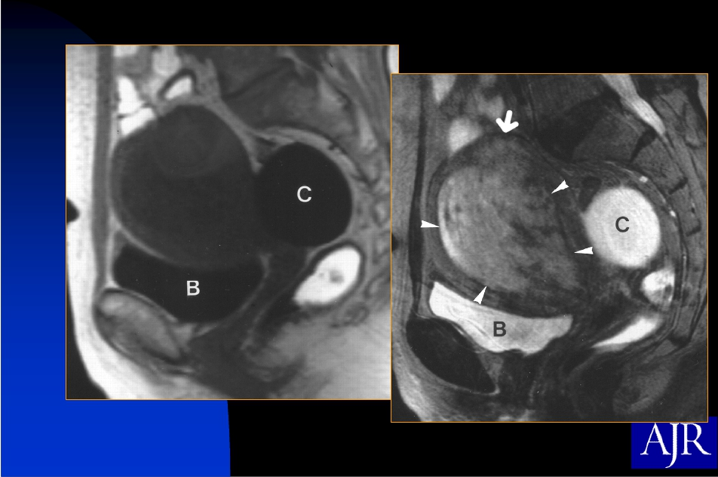
子宫肉瘤 58岁
--High-grade endometrial stromal sarcoma in a 58-year-old woman
T1WI
T2WI
Rha, S. E. et al. Am. J. Roentgenol. 2003;181:1369-1374
2009-8-7
Liaoning Cancer Institute and
Hospital
69

Slide 70
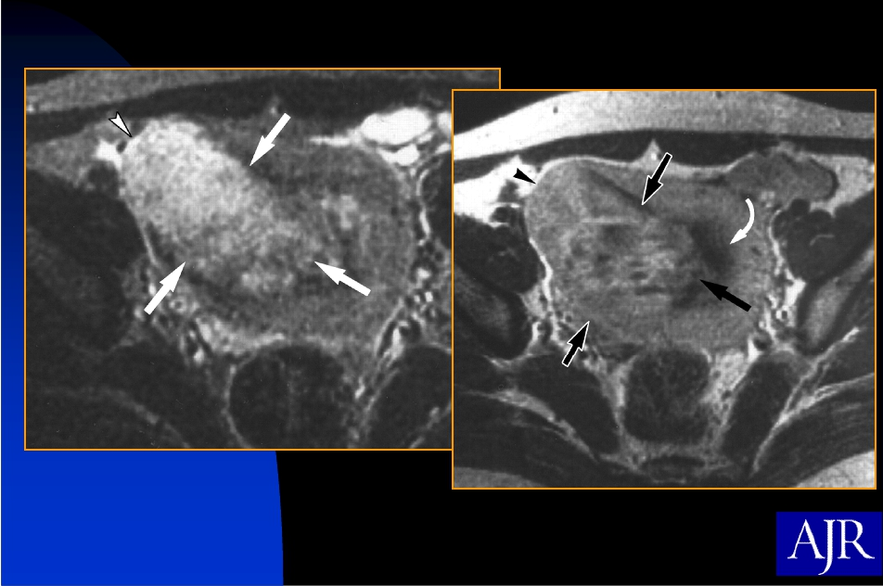
子宫肉瘤 20岁
-- High-grade endometrial stromal sarcoma in a 20-year-old woman
Rha, S. E. et al. Am. J. Roentgenol. 2003;181:1369-1374
2009-8-7
Liaoning Cancer Institute and
Hospital
70

Slide 71
结语
Summary
n
n
随着技术的进步，MRI在子宫恶性肿瘤的诊治领域得
到了飞速的发展。目前，MRI已成为子宫恶性肿瘤分
期和疗效评价的最佳手段，但在Ⅰa期早期病变的诊
断、分期上仍应用受限
With the developement of MRI technique, it has made a rapid progress
in diagnosis and staging of uterine malignant tumor. Although MRI has
become the best approach to evaluate uterine malignant tumor stage
and therapy effect, it plays an unimportant role in stageⅠa tumor
MRI的临床应用已由形态学诊断向功能影像的方向发
展，日益成为现代医学不可缺少的诊断手段和工具
Clinical application of MRI has been changed from disease morphology
diagnosis to its functional image.It will gradually become an
indispensable diagnostic method and tool on medicine
2009-8-7
Liaoning Cancer Institute and
Hospital
71

Slide 72
n
如何将MRI领域的最新技术，特别是功能成像，应用
于子宫恶性肿瘤的早期诊断、准确分期和客观疗效
评价，推动子宫恶性肿瘤治疗的进步，是我国影像
医学工作者近期面临的重要课题
How to apply advanced MRI technique, especially functional image, for
uterine malignant tumor to provide its early diagnosis, accurate staging
and objective therapy information and to promote the therapy level on
uterine tumor has been important for radiologists
2009-8-7
Liaoning Cancer Institute and
Hospital
72

Slide 73
Thank you for your
attention！
2009-8-7
Liaoning Cancer Institute and
Hospital
73

